Slide 1
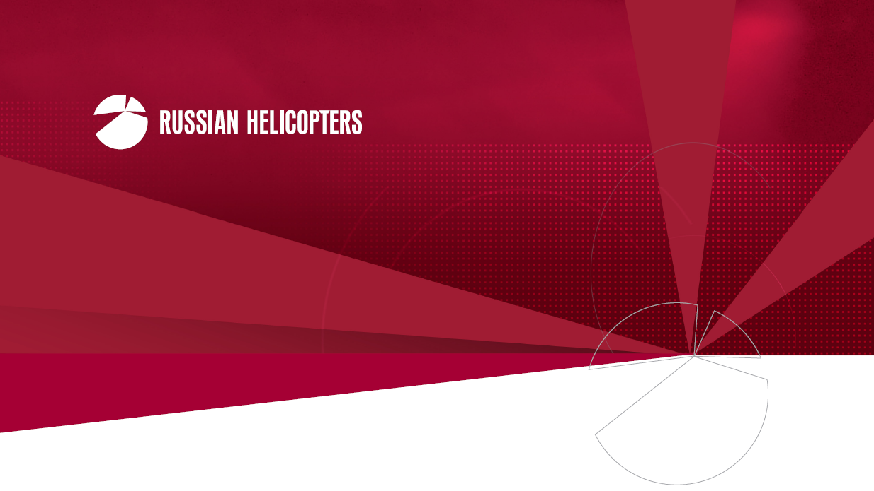
COMPANY PROFILE
© 2013 Russian Helicopters, JSC All rights reserved

Slide 2












STRUCTURE
MORE THAN
41,000 EMPLOYEES
Oboronprom
Russian Helicopters
Mil Moscow Helicopter Plant
Kazan Helicopters
SMPP
Helicopter Service Company
Kamov
Rostvertol
Reduktor-PM
Moscow and region
(9,000 employees)
NARP
Kazan
(6,500 employees)
Ulan-Ude Aviation Plant
Perm
(1,800 employees)
Progress Arsenyev Aviation Company
Rostov-on-Don
(7,900 employees)
Kumertau
(4,000 employees)
Kumertau
Aviation PE
Novosibirsk
(500 employees)
Arsenyev
(6,000 employees)
Ulan-Ude
(6,000 employees)
© 2013 Russian Helicopters, JSC All rights reserved

Slide 3
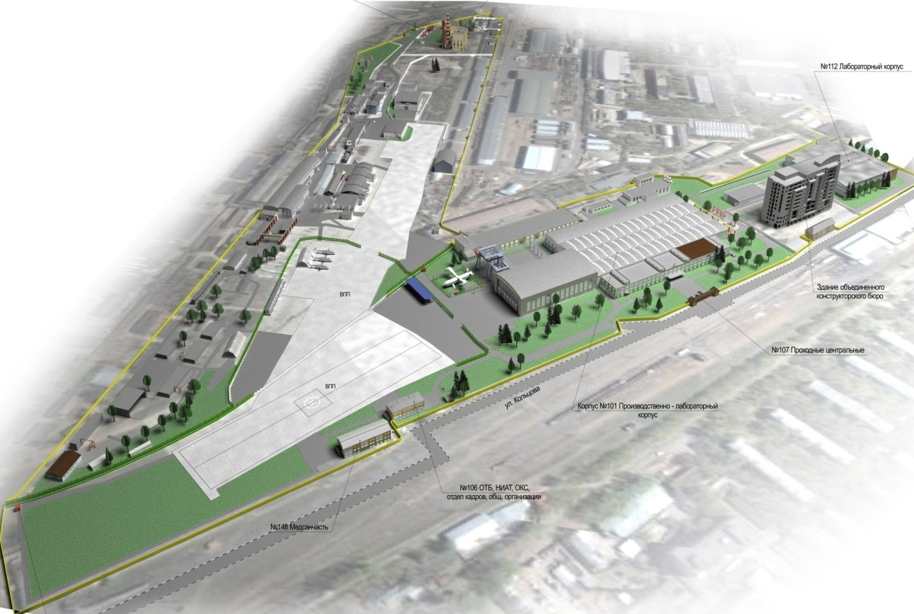
TOMILINO R&D COMPLEX
Experimental Research Center
Logistics Center
Helicopter Engineering Center
Prototype Production Center
Area ……………..…..... 41 ha
Buildings ……… …… 65
Staff………………….... 3,500 employees
Commissioning .…..... 2011…2015
Flight Test Сenter
© 2013 Russian Helicopters, JSC All rights reserved

Slide 4


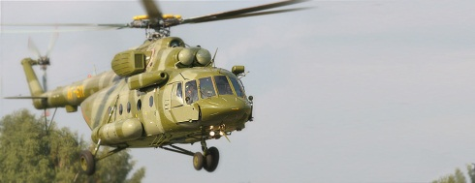




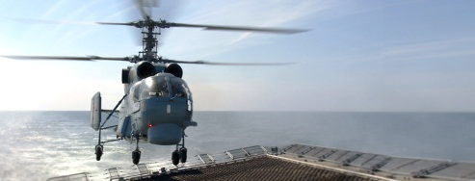
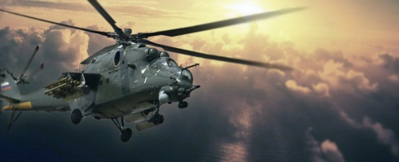

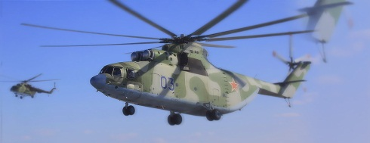
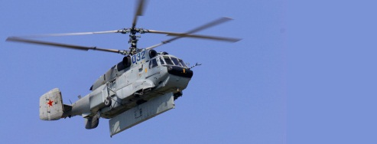
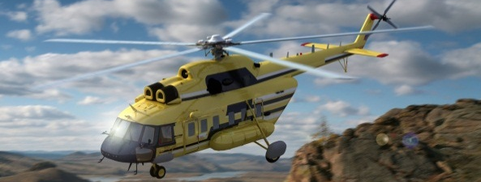


MODEL RANGE
Civil Helicopters
Military Helicopters
Mi-171SH Mi-17V-5
Ka-52
Ansat
Ka-226T
Mi-28N
Ka-27/Ka-28
Ka-32А11ВС
Mi-8/17
Mi-24 / 35М
Mi-26Т
Mi-26
Ka-31
Coming soon
Mi-171А2
Mi-38
Ka-62
© 2013 Russian Helicopters, JSC All rights reserved

Slide 5

GROWTH DYNAMICS: HELICOPTER PODUCTION
JSC “Russian Helicopters” established
290*
262
214
158
186
94
102
* - FORECAST
Growth factors:
Product line diversification
Technological re-equipment of production sites
Domestic civil helicopter market development
Expansion to newer markets with brand new competitive models compliant with the strictest international safety requirements
International cooperation
Service enhancement, helicopter operators’ support worldwide
© 2013 Russian Helicopters, JSC All rights reserved

Slide 6
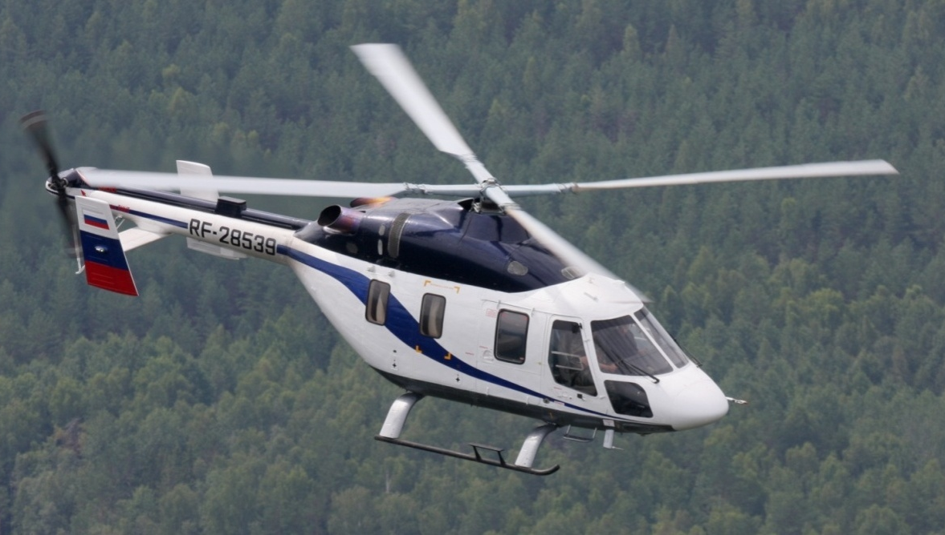
ANSAT
Performance
Power plant | 2 х PW-207K
Max TOW, kg | 3 600
Payload, kg | 1 350
Flight range, km | 510
Max speed, km/h | 275
Cruise speed, km/h | 250
Hover ceiling, m | 3 300
Service ceiling, m | 5 500
Capacity, pax. | 8
Missions:
Cargo
Passenger
VIP
Medevac
Patrolling
Search and Rescue
Training
© 2013 Russian Helicopters, JSC All rights reserved
Notes:
Заголовок раздела

Slide 7
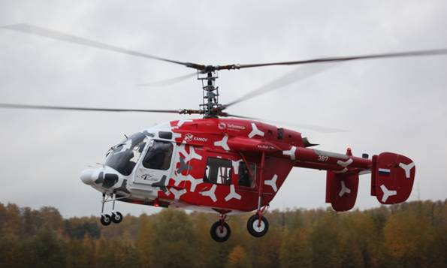
Ka-226Т
Performance
Max TOW, kg | 3 600
Cruise speed, km/h | 220
Max speed, km/h | 250
Flight range (aux. fuel tanks), km | 700
Weight of cargo inside cabin, kg | 1 100
Weight of cargo on external load, kg | 1 000
Crew | 1-2
Capacity, Pax. | 6
Missions:
Cargo
Passenger
Medevac
Patrolling
Search and Rescue
© 2013 Russian Helicopters, JSC All rights reserved

Slide 8
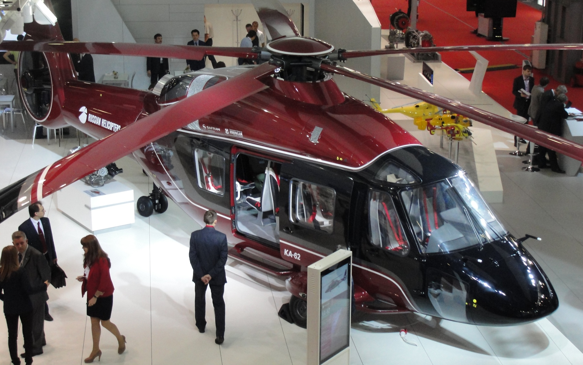
Ka-62
Performance
Max TOW, kg | 6 500
Cruise speed, km/h | 290
Max speed, km/h | 310
Flight range, km | 750
Weight of cargo inside cabin, kg | 2 100
Weight of cargo on external load, kg | 2 500
Crew | 1-2
Capacity, Pax. | 15
Missions:
Cargo
Passenger
VIP/VVIP
Patrolling
Search and Rescue
© 2013 Russian Helicopters, JSC All rights reserved

Slide 9
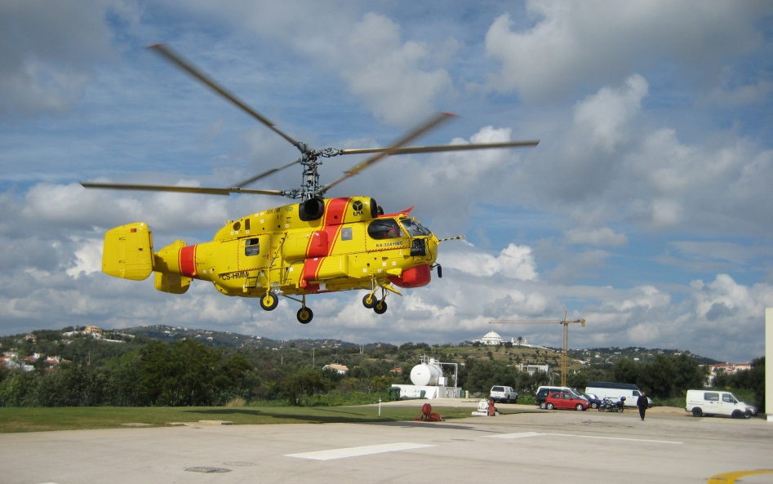
Ka-32А11ВС
Performance
Max TOW, kg | 11 000
Max TOW (External), kg | 12 700
Cruise speed, km/h | 230
Max speed, km/h | 260
Flight range, km | 670
Weight of cargo inside cabin, kg | 3 700
Weight of cargo on external load, kg | 5 000
Crew | 1-3
Capacity, Pax. | 13
Missions:
Cargo
Patrolling
Search and Rescue
Medevac
Firefighting
© 2013 Russian Helicopters, JSC All rights reserved

Slide 10
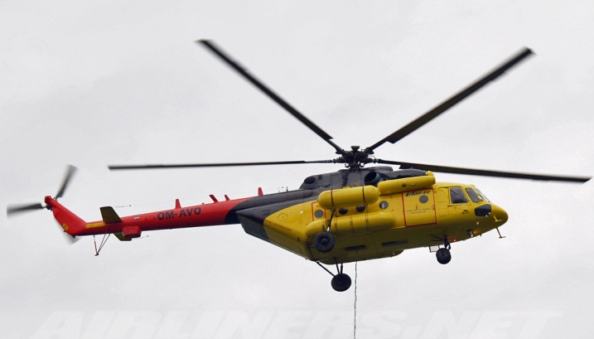
Mi-8/17
Performance
Max TOW, kg | 13 000
Cruise speed, km/h | 230
Max speed, km/h | 250
Flight range, km | 650
Weight of cargo inside cabin, kg | 4 000
Weight of cargo on external load, kg | 4 000
Crew | 3
Capacity, Pax. | 26
Missions:
Cargo
Passenger
VIP/VVIP
Medevac
Patrolling
Search and Rescue
Firefighting
© 2013 Russian Helicopters, JSC All rights reserved

Slide 11
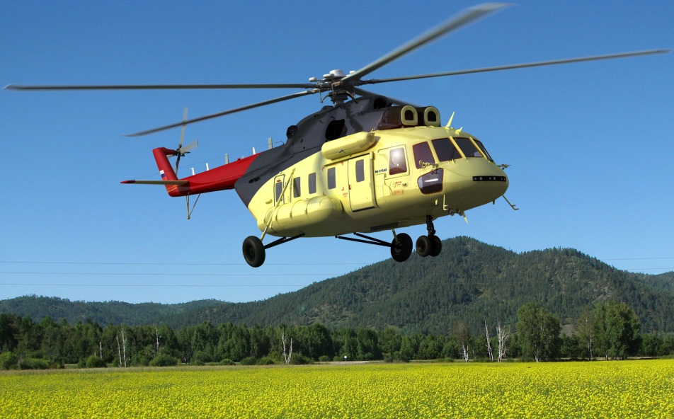
Mi-171A2
Performance
Max TOW, kg | 13 000
Max TOW (External), kg | 13 500
Cruise speed, km/h | 260
Max speed, km/h | 280
Flight range, km | 800
Weight of cargo inside cabin, kg | 4 000
Weight of cargo on external load, kg | 5 000
Crew | 1-2
Capacity, Pax. | 24
Missions:
Cargo
Passenger
VIP/VVIP
Medevac
Patrolling
Search and Rescue
Firefighting
© 2013 Russian Helicopters, JSC All rights reserved

Slide 12
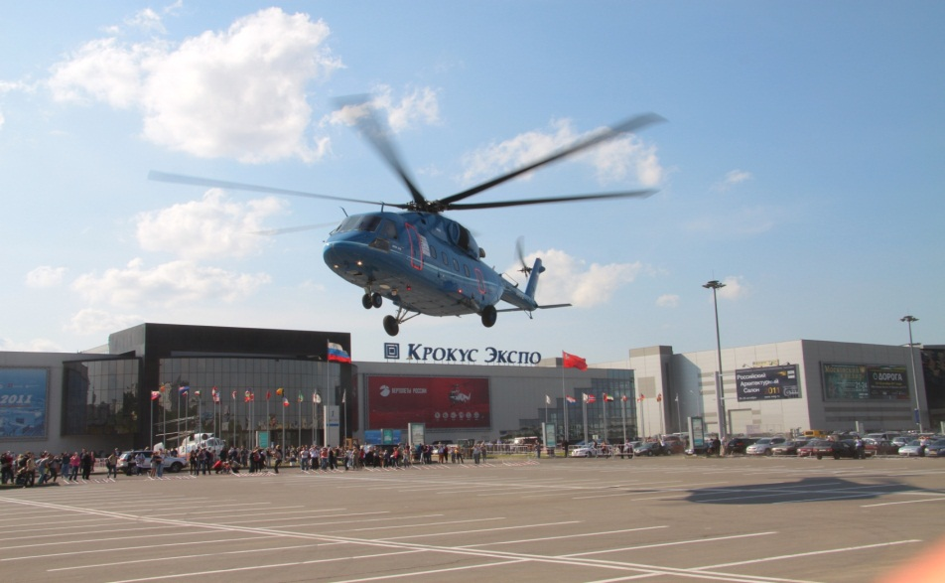
Mi-38
Performance
Max TOW, kg | 15 600
Cruise speed, km/h | 285
Max speed, km/h | 330
Flight range, km | 900
Weight of cargo inside cabin, kg | 6 000
Weight of cargo on external load, kg | 7 000
Crew | 2
Capacity, Pax. | 30
Missions:
Cargo
Passenger
VIP/VVIP
Medevac
Search and Rescue
Firefighting
© 2013 Russian Helicopters, JSC All rights reserved

Slide 13
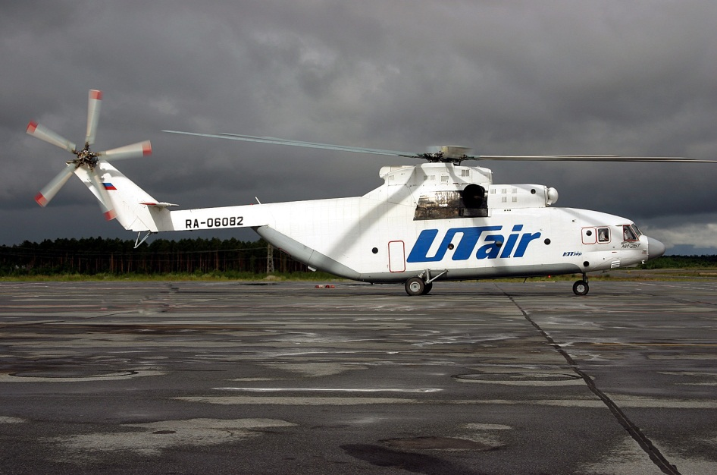
Mi-26T
Performance
Max TOW, kg | 56 000
Cruise speed, km/h | 255
Max speed, km/h | 295
Flight range, km | 800
Weight of cargo inside cabin, kg | 20 000
Weight of cargo on external load, kg | 20 000
Crew | 5
Missions:
Cargo
Refueling
Search and Rescue
Medevac
Firefighting
© 2013 Russian Helicopters, JSC All rights reserved

Slide 14
THANK YOU FOR YOUR ATTENTION!
© 2013 Russian Helicopters, JSC All rights reserved

