Slide 1
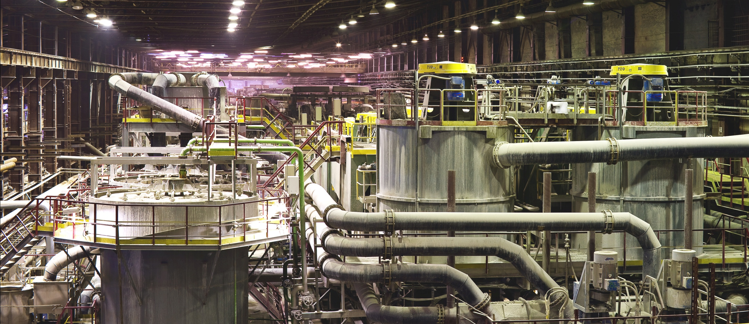
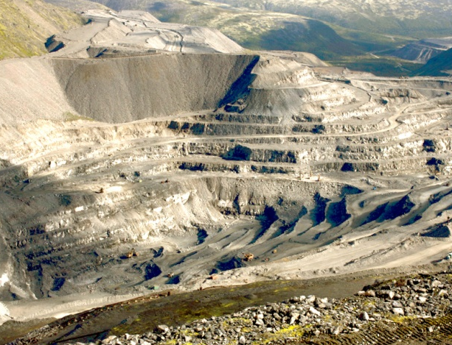
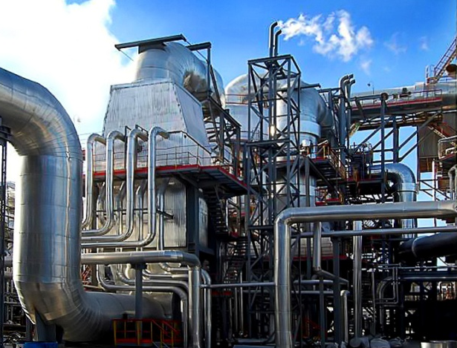
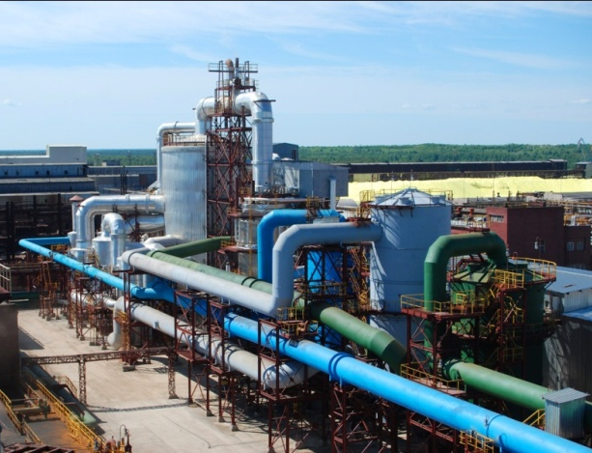
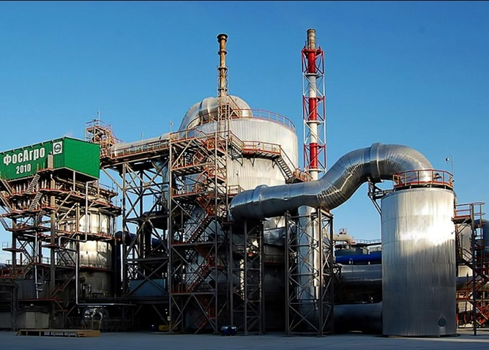
Focus on South-East Asia
March 2013
1
Notes:
0

Slide 2
PhosAgro at a glance
World class integrated phosphate producer
#1 global producer of high-grade phosphate rock
#2 global DAP/MAP producer⁽¹⁾
Overall fertilizer capacity: 6.1 mln t
Leading global phosphate rock producers (by production)
2011, mln t, excluding Chinese producers
#1 producer of high-grade phosphate rock (>35.7% P₂O₅)
Large high quality apatite-nepheline ore
2.1 bln t of ore resources⁽²⁾ (over 75 years of production)
Self-sufficiency in key feedstocks provides for low costs
100% self-sufficient in phosphate rock
72%-90% self-sufficient in ammonia⁽³⁾
More than 40% self-sufficiency in electricity
Leading global DAP/MAP producers (by capacity)
2012, mln t, excluding Chinese producers
Flexible production and sales
Flexible production lines
Phosphate fertiliser capacities of 4.2 mln t, 1.8 mln t fully flexible into NPK production
Leader in Russian fertiliser market growing twice faster than the world consumption
Global presence
Note: (1) Excluding Chinese producers
(2) PhosAgro, IMC as of June 2011
(3) self –sufficiency depends on the composition of the products produced by PhosAgro
Source: FERTECON, IFA, companies data, PhosAgro
Source: FERTECON, FMB, IFA, companies’ data, PhosAgro
1

Slide 3
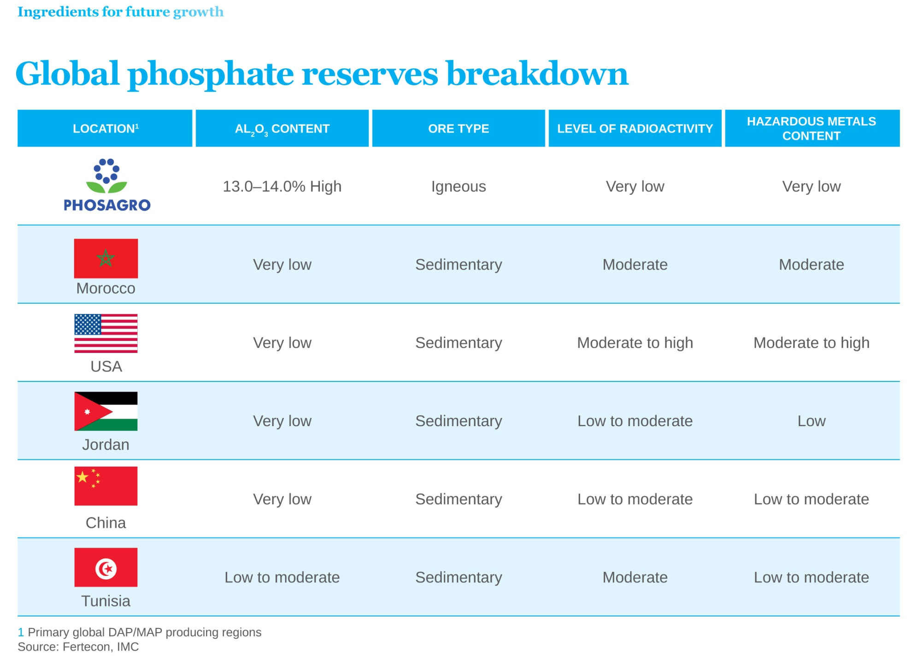
Quality of phosphate rock
1

Slide 4
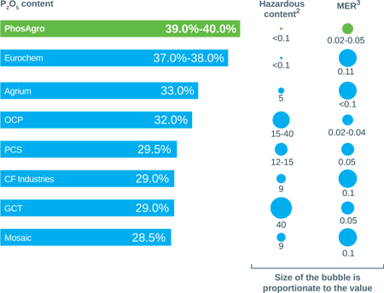
Quality of phosphate rock
2 – average cadmium content in ppm
3 – Average Minor Element Ratio > 0.1 not suitable for production of high quality DAP
Source: FERTECON, PhosAgro, companies’ data,
1

Slide 5
PhosAgro Product Mix
2012
Potential NPK/PKS production of 12 mln tpa
Overall: 12 mln t
Total: 5.4 mln t
AN
UREA
NPS
MCP
APP
NPK
PKS
MAP
DAP
Total: 1.86 mln t
Total: 1.1 mln t
Total: 1.9 mln t
Phosphoric acid
New
NPK
Ammonia
Phosphoric acid
Ammonia
MOP
0.6
MOP
3.0
4
Source: PhosAgro
15
Notes:
4

Slide 6
PhosAgro Products
Concentrates
Phosphate rock
Nepheline concentrate
Titanomagnetite concentrate
Syenite alumino alkaline concentrate
Aegirine concentrate
Titenite concentrate
Phosphate Fertilizers
MAP 12:52
Beige and colored DAP 18:46
NPS 20:20+14(S);
NP 16:20+12(S)
NPS 14:34+8(S)
Liquid complex fertilizer (APP 11:37)
NPK 15:15:15
NPK 13:19:19
NPK 10:20:20
NPK 9-25-25/10:26:26
NPK 16:16:08
NPK 12:32:12
Nitrogen Fertilizers
Ammonium nitrate
Complex nitrogen fertilizers (NP 32:5)
Urea 46%
Other Products
Feed phosphate(MCP)
Ammonia Solution
Nitric Acid
Sodiumsilicofluoride
Sulphuric Acid
Oleum
Powdered sodium tripolyphosphate
Potassium sulphate (sulphate of potash)
Potassium carbonate (carbonate of potash)
1

Slide 7
Thailand Import Data
Product | 2012 | 2011 | 2010
Urea | 1,990,241 | 2,085,408 | 2,124,966
DAP | 533,482 | 389,441 | 462,736
MOP | 537,666 | 752,701 | 512,507
AmSul | 269,258 | 273,853 | 352,057
NP 16-20 | 491,726 | 564,928 | 493,112
NPK 15-15-15 | 329,631 | 376,907 | 408,647
NPK 16-16-16 | 324,547 | 388,777 | 248,692
NPK 13-13-21 | 31,456 | 23,671 | 51,663
NPK 14-14-21 | 26,866 | 50,195 | 50,178
Other | 557,000 | 664,600 | 409,500
Total | 5,091,873 | 5,570,481 | 5,114,058
1

Slide 8
PhosAgro Sales to SE Asia and Thailand
PhosAgro made a decision to develop sales in SE Asia in 2012
During the first year PhosAgro achieved the following results in the region:
442,000 mt of fertilizers sold in SE Asia
346,000 mt or USD160 mln to Thailand (80%)
245,000 mt were sold in bulk vessels
101,000 mt in containers
1

Slide 9
PhosAgro Strategy in the Region
Goal: double sales to the SE Asia region during next 2 years.
Thailand - main growth driver through developed marketing channels.
Challenges: 2012 and 2013 draught conditions in Thailand continue to negatively effect fertilizers consumption.
Share of deliveries in containers will increase:
Better logistics/flexibility
preserves quality of the products during delivery time.
1

Slide 10
PhosAgro Asia
PhosAgro’s first international office in Singapore opened
(March 2013)
Objectives:
Establish presence in key Asian markets
Gain better understanding of the markets
Establish direct trade relationship with importers
Provide competitive financing opportunities to our customer
Seamless execution of contracts.
1

Slide 11
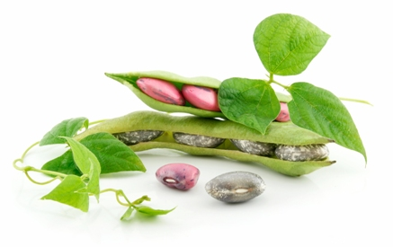
Thank You

